Slide 1
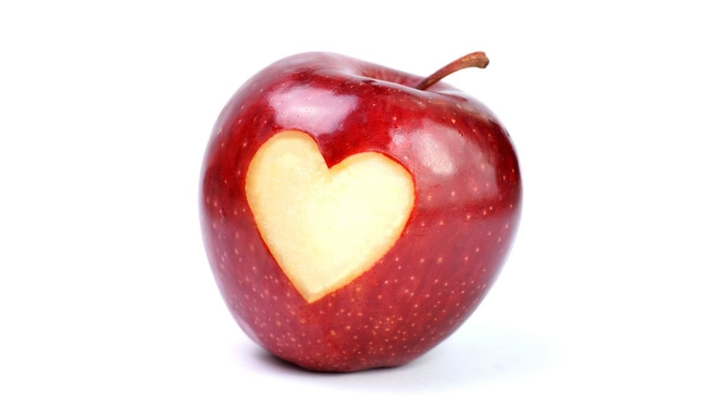
Healthy Food In My Life ☻

Slide 2
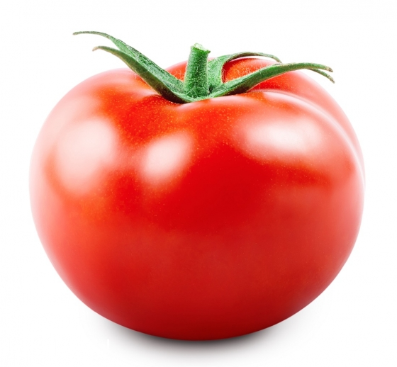
WHAT HEALTHY FOOD I AM EAT?
In My Life I Eat Vegetables And Fruits
I drink Milk And Water
I Eat Fish

Slide 3
What I Like The Most?
Cucumbers
Apples
Water Melons
Milk
Broccoli
MY FAVOURITE HEALTHY FOOD
TOMATO SOUP
BROCOLI SOUP
MILK AND CORN FLAKES

Slide 4
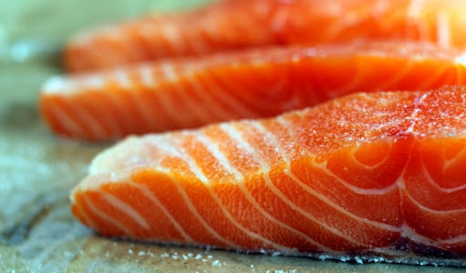
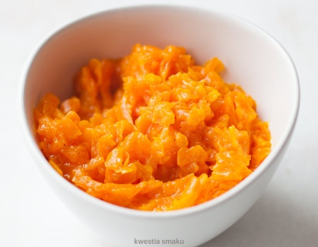
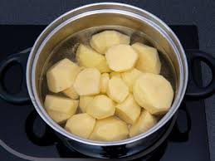
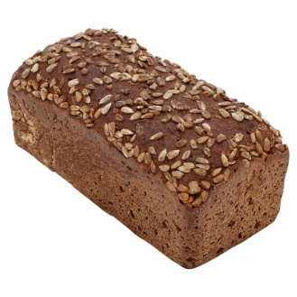
What I Eat
Breakfast : Milk And Corn Flakes
Diner : Fish Potatoes And Carrot
Supper : Dark Bread And Egg

Slide 5
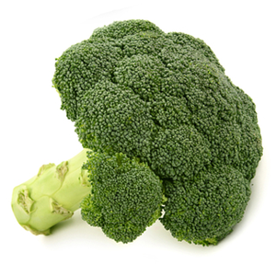
We needs to eat more wegetables and fruits no sweets because healthy food have got lots vitamins

Slide 7
Thanks For Wathing (Dziękuję Za Oglądanie) Łucja Gałka 5a

